Slide 1



NIKITA PARTA (CSE AIML 3B) SARTHAK GUSAIN (CSE AIML 3B) SHIVAM SHARMA (IT 3B) ANANYA PRASAD (ECE 3A) PRAKHAR BHATNAGAR (ECE 3A) PRAKHAR SAHU (ECE 3A)

Slide 2



globalization has interconnected people and businesses worldwide so there's a need for effective communication across languages to facilitate trade, collaboration, and understanding.
They have a user-friendly interface and availability for both individuals and businesses. It is accurate and reliable and advancements in machine learning and artificial intelligence that have improved the translation quality over time
These tools facilitate communication with international clients, partners, and customers from different linguistic backgrounds, thereby expanding market reach. These tools also enables diplomats and government officials to communicate effectively with counterparts from other countries.
There's a huge diversity of languages spoken around the world. Diversity poses challenges for effective communication, especially in international business, diplomacy, and social interactions.
So, language translation is a solution to overcome this language barrier.
Examples of popular translation tools: Google Translate, DeepL, and Microsoft Translator.
Therefore, these tools play a vital role in fostering communication, collaboration, and understanding across linguistic boundaries.

Slide 3


The primary objective of our English to Hindi Language Translator Tool is to facilitate effective communication and knowledge dissemination by providing accurate and reliable translations from English to Hindi. Our project aims to achieve the following objectives:
User-Friendly Interface: Design an intuitive and user-friendly interface tailored to the needs of our target users, making the translation process simple and accessible to individuals with varying levels of technological proficiency.
Accurate Translation: Develop a translation mechanism that ensures the accuracy and fluency of English text converted into Hindi, enabling users to comprehend the content seamlessly.
Real-Time Translation: Implement real-time translation capabilities to enable users to translate English text into Hindi instantaneously, facilitating smooth communication in various contexts, such as online conversations or educational settings.
Education and Empowerment: Promote language
learning and cultural exchange by offering educational resources and tools within the platform, empowering users to expand their linguistic skills and deepen their understanding of Hindi language and culture.

Slide 4

JOURNALISTS AND RESEARCHERS
Tourism and Hospitality Industry
BUSSINESS
TRAVELERS AND TOURISTS
PROFESSIONALS
INTERNATIONAL ORGANZIATIONS
PEOPLE WITH SEVERAL DISABILITIES
STUDENTS AND EDUCATORSF
EXPATRIATES AND MIGRANTS
LEGAL AND MEDICAL PROFESSIONALS
GOVERNMENT AGENCIES

Slide 5



Text Translation: The core function of translator tools is to translate text from one language to another.
Users can input text in one language and receive the
translated version in their
desired language.
Dictionary and Definitions: Translator tools often include built-in dictionaries and definitions to provide additional context and clarity for translated words or phrases.
Voice Translation: Voice translation features enable users to speak or dictate in one language and receive spoken translations in another language.
This is useful for verbal communication in multilingual settings.
Cross platform integration:
Many translator tools are available across multiple platforms, including web browsers, mobile devices, and desktop applications, allowing users to access translations across different devices.

Slide 6
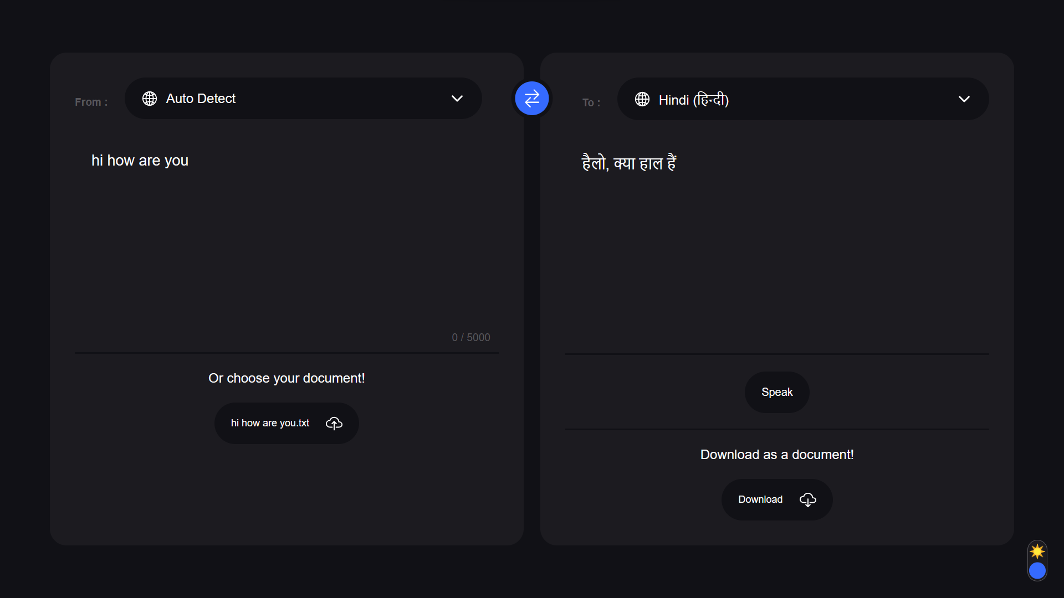
User Interface of the Website:

Slide 7
Certainly! Here's the revised version of your slide without the hashtags: Project Resources- Front-End Development - HTML5 - Structure and content of the web application. - CSS3 - Styling and layout enhancements, including responsiveness. Client-Side Scripting - JavaScript - Interactive elements and dynamic content. - AJAX for asynchronous web requests. APIs - Google API - [Specify which Google APIs were used, e.g., Maps, Places, Drive, etc.] - Integration for [describe the functionality added, e.g., displaying maps, fetching places, storing files in Drive, etc.]
RESOURCES USED :

